Slide 1

Designing a Login and Registration System - All Parts Completed
Jake Bolger C18395341

Slide 2
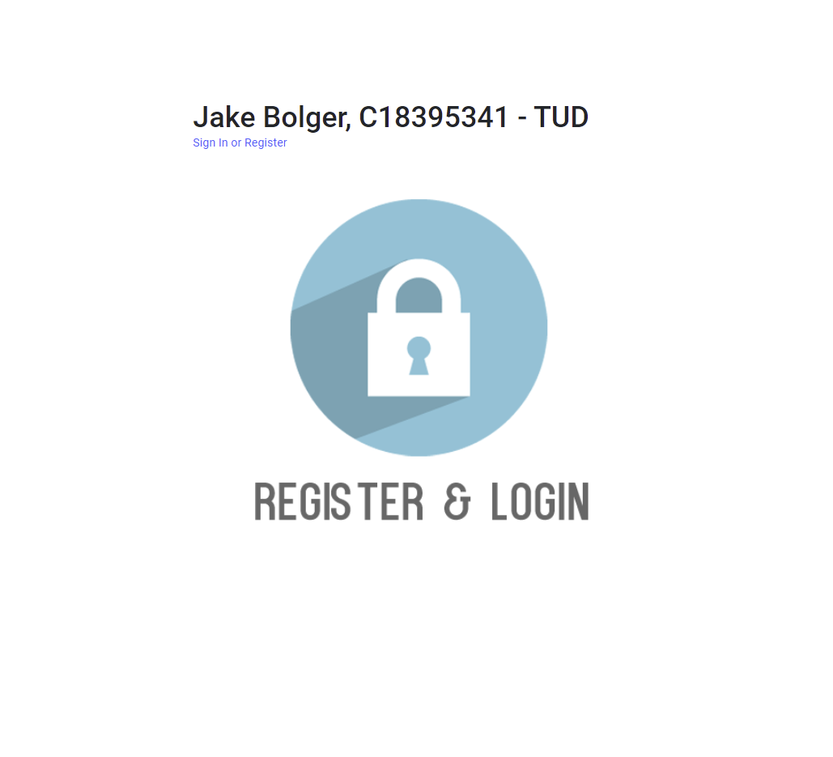
Main Page

Slide 3
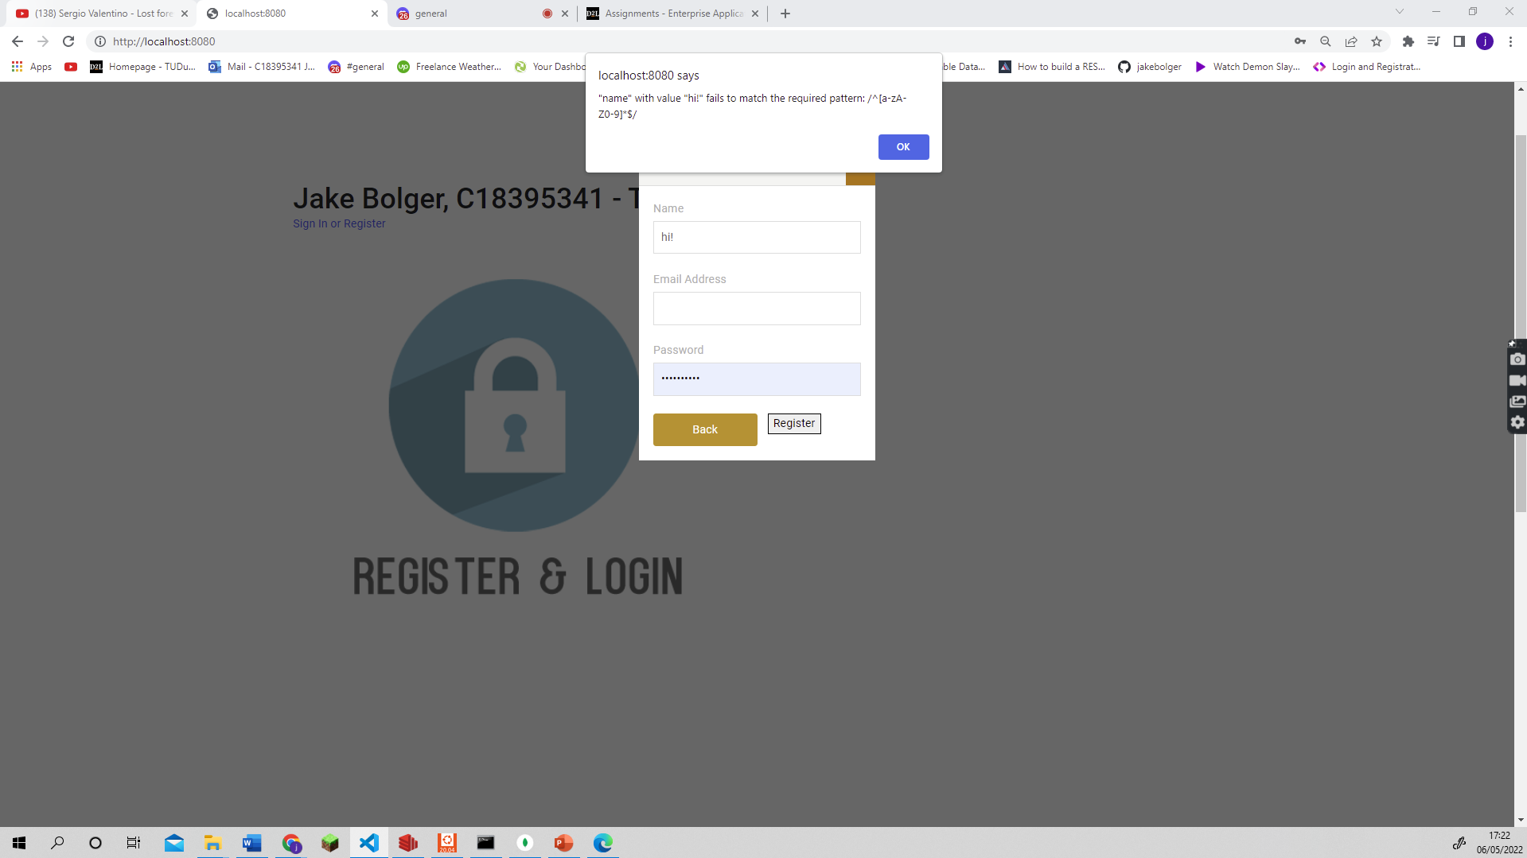
Errors for Registering
Username numbers and letters

Slide 4
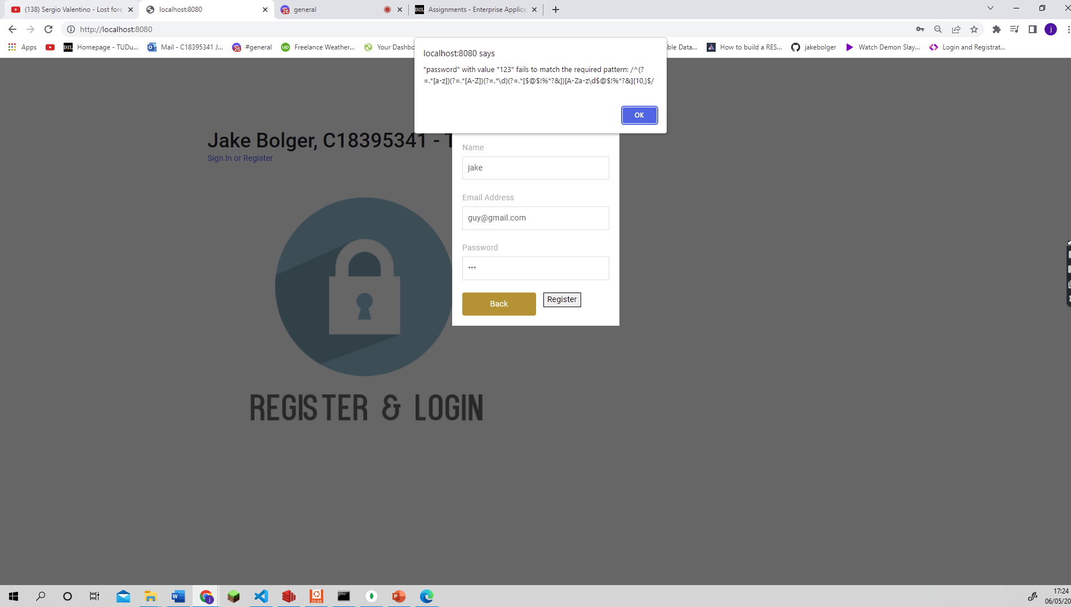
Errors for Registering
Password error match

Slide 5
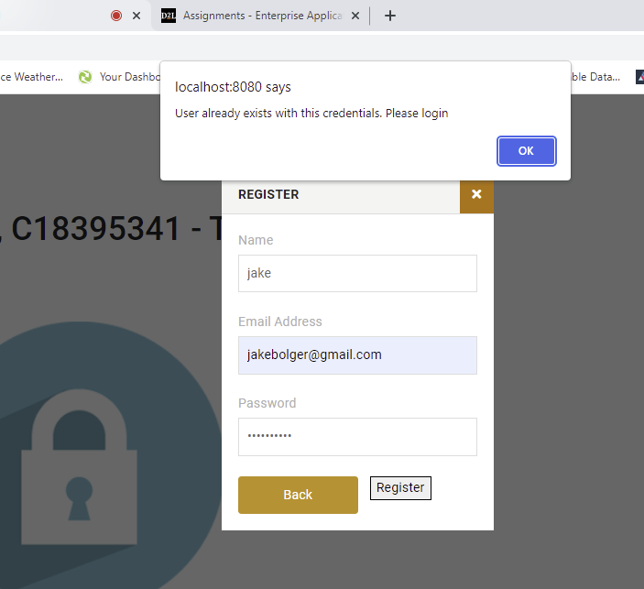
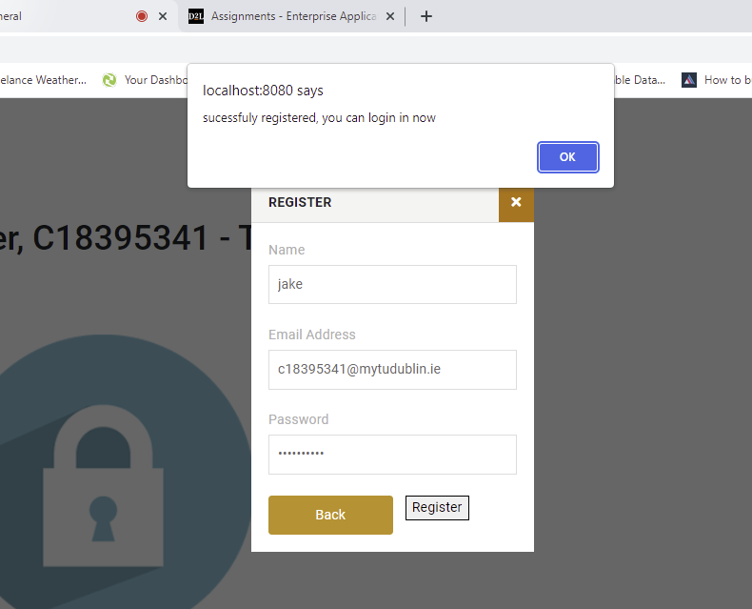
Errors for Registering
Email in Use
Register Success

Slide 6
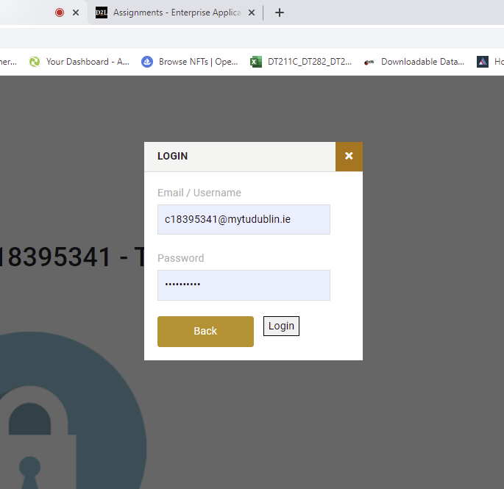
LOGIN

Slide 7
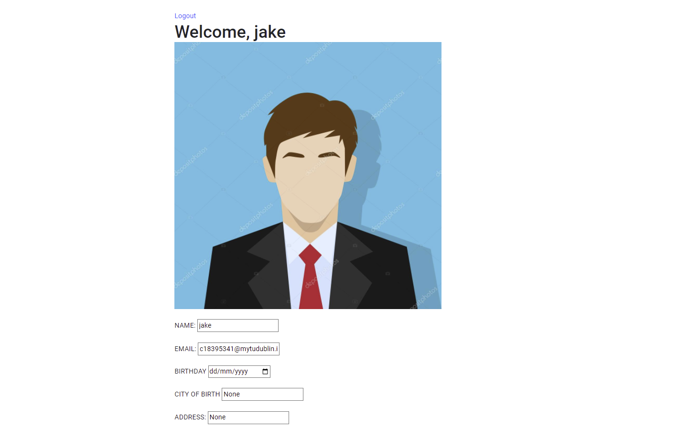
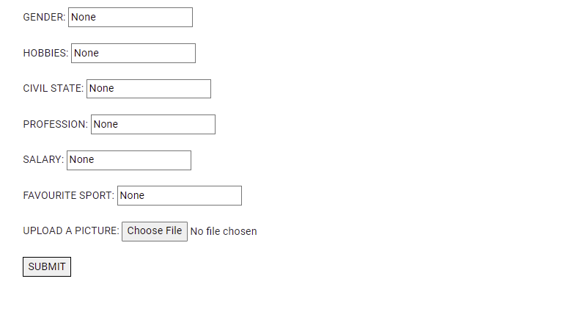
Home Page when logged in

Slide 8
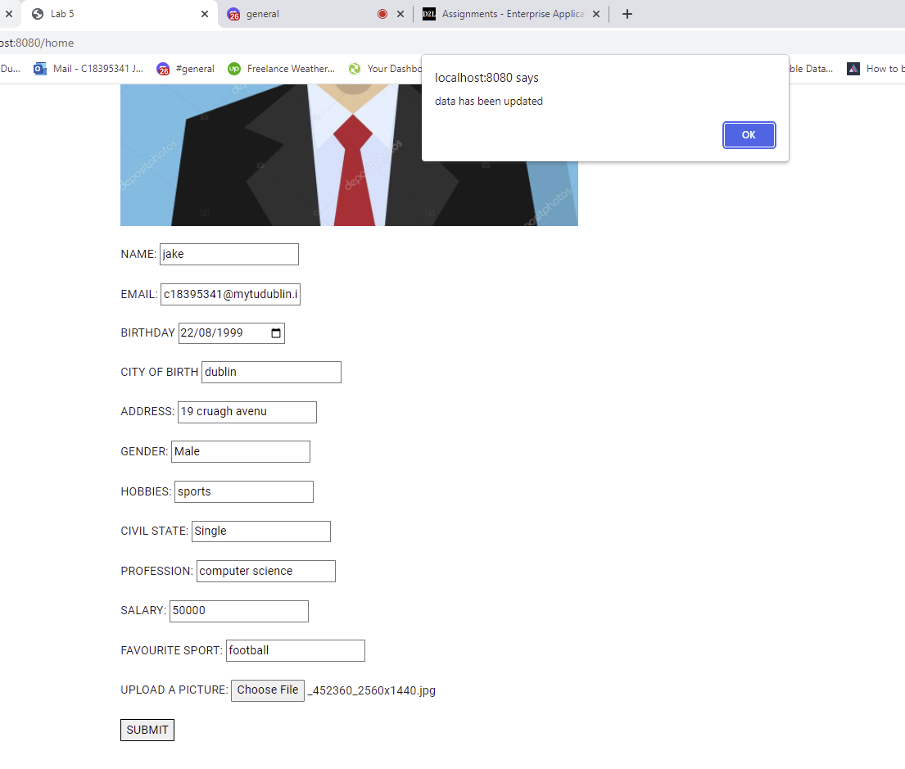
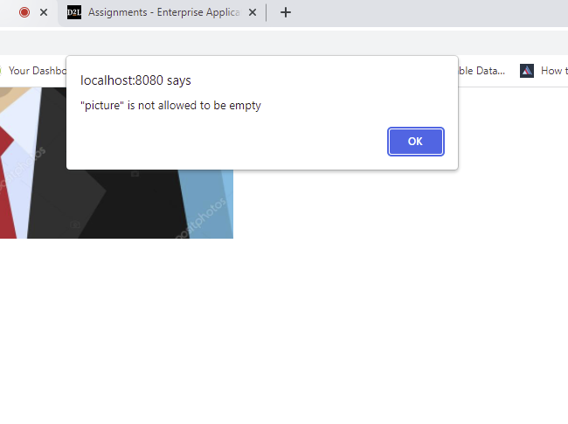
Fields error and filled
Saving data message is successful

Slide 9
Diagram for Structure & Interaction Diagram
Redis
Mongodb,
Bycript
Client
Server
App.js
Routes/statics.js
Post Request for Register
Routes / users.js
Models / users.js
MongoDB
Post Request for Login
Regex
Post request for data update
View / index.html
View / home.html
MongoDB
Logout
Assets/js/scripts
Bootsrap and JQuery

Slide 10
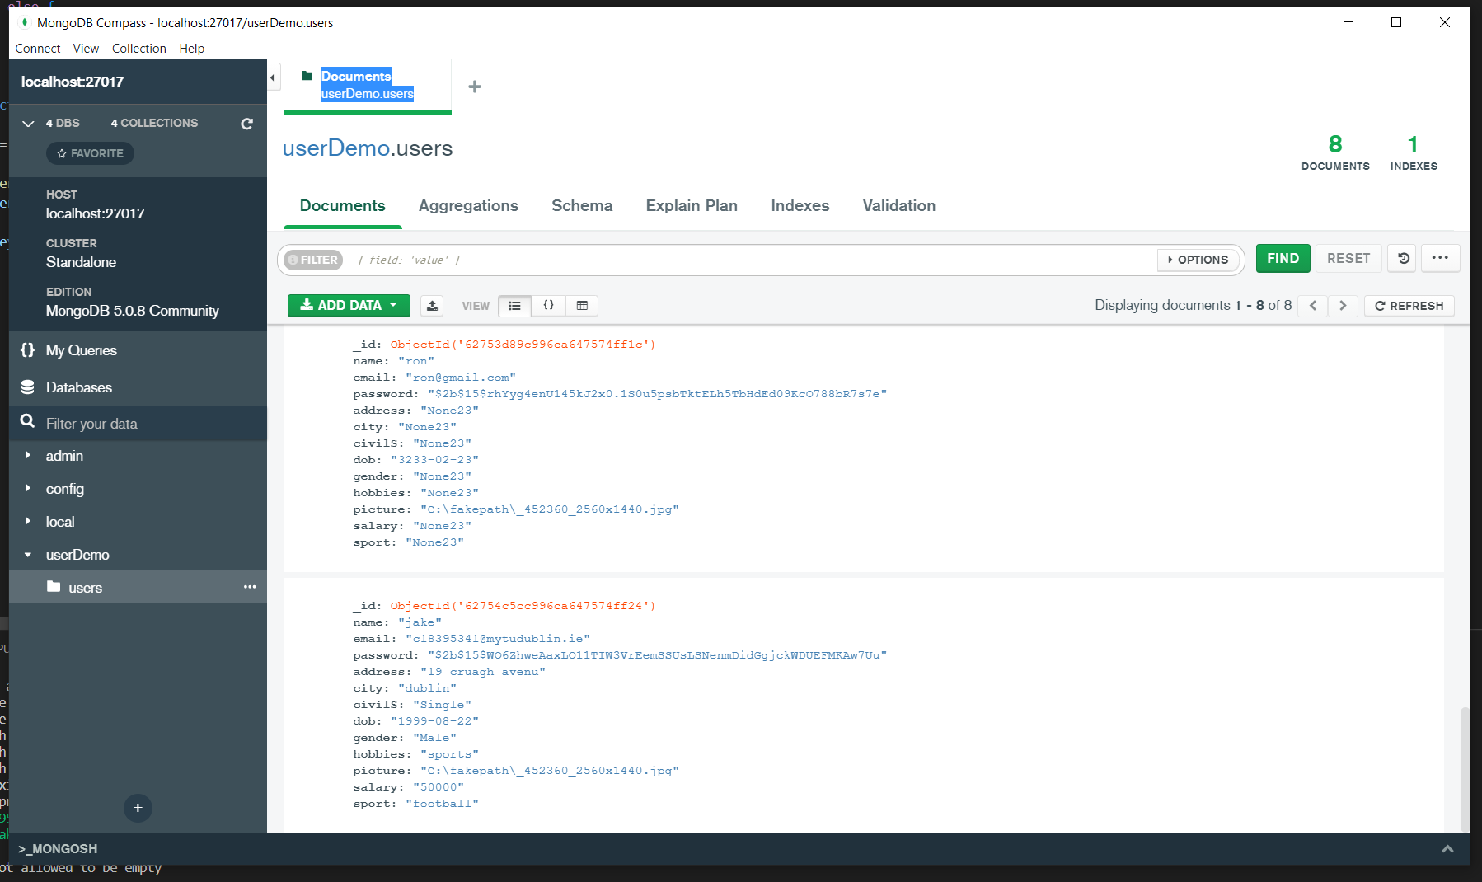
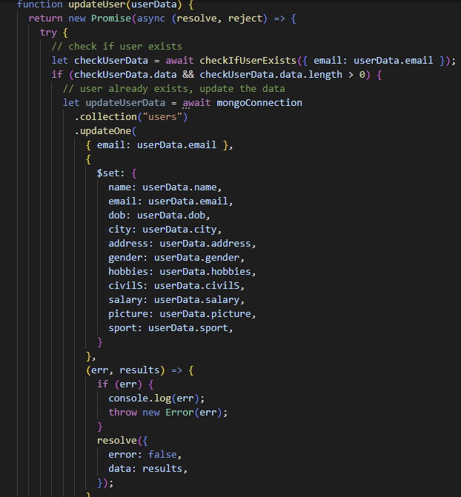
Screen Shots to show is done –
Code for updating user
mongoDB updated details entered.

Slide 11
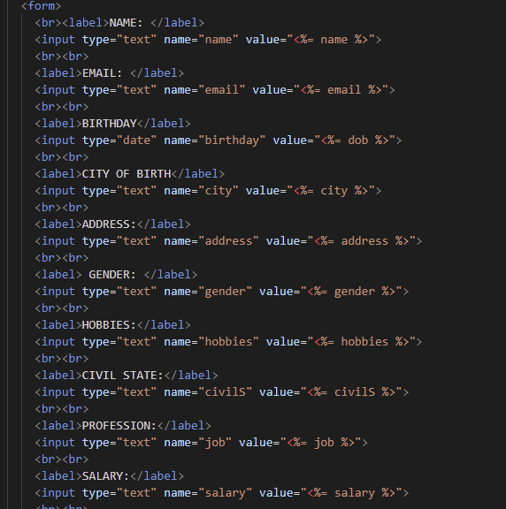
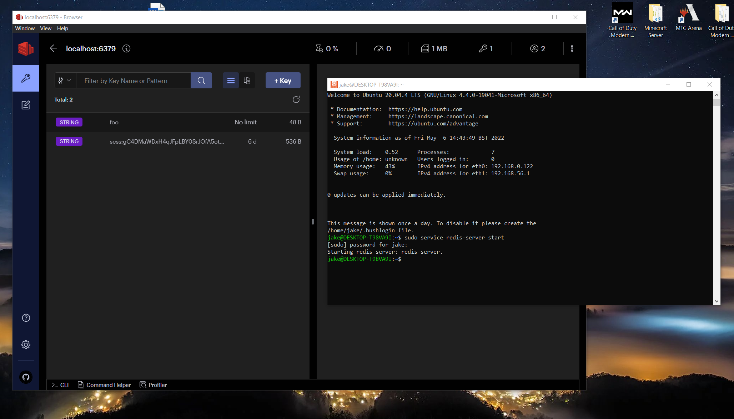
JQUERY + Bootstrap , and Redis

Slide 12
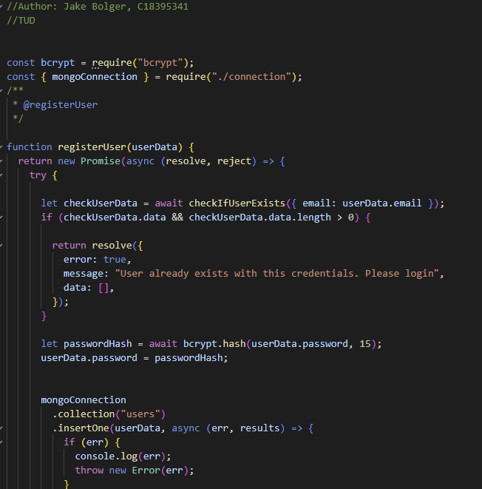
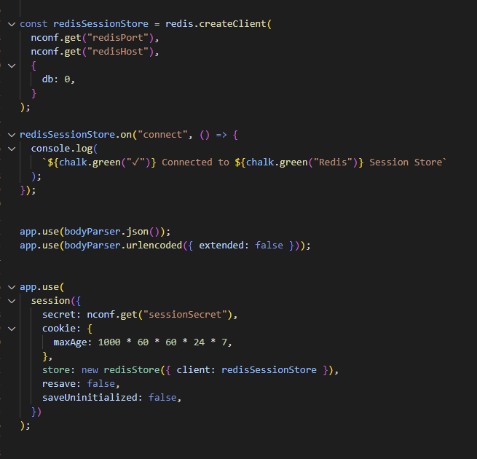
Redis
Bycript password

Slide 13
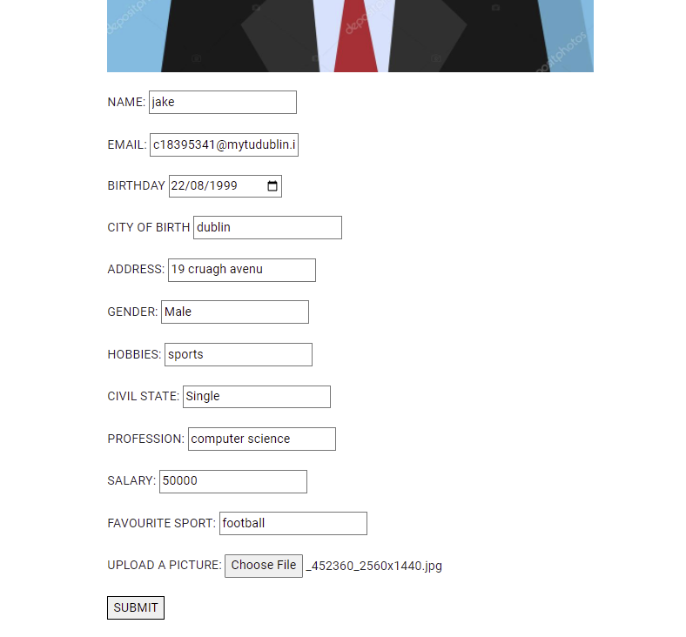
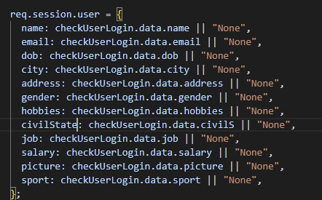
Editing Details & Data
Default Values

Slide 14
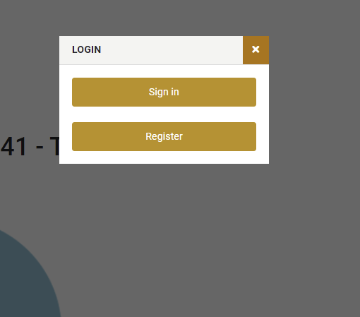
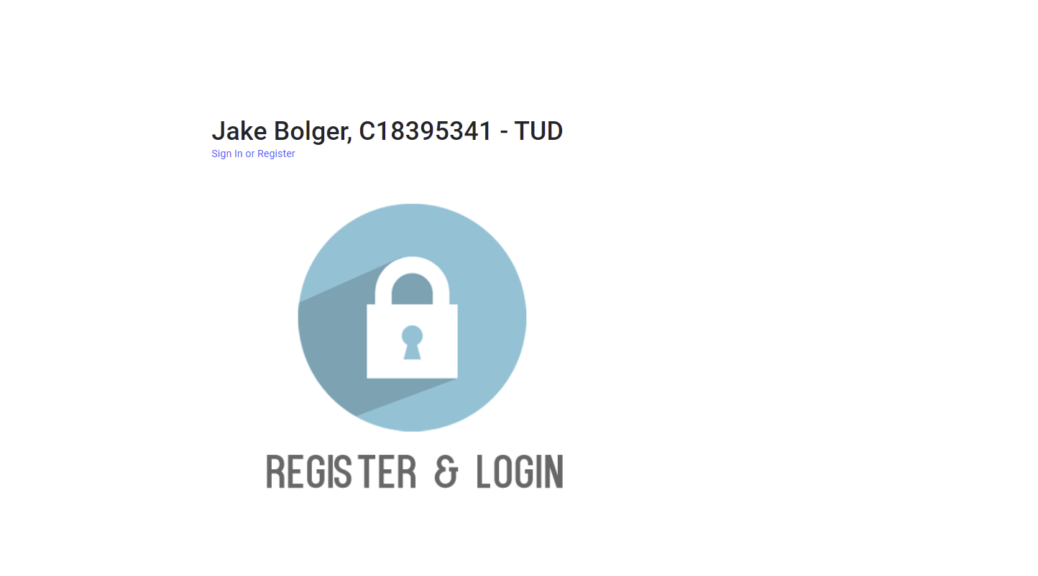
Home Page
Login and Register

